Slide 1

STANLEY COLLEGE OF ENGINEERING AND TECHNOLOGY FOR WOMEN (AUTONOMOUS) Abids. Hyderabad – 500 001 (Affiliated to Osmania University & Approved by AICTE) (All eligible UG Courses are accredited by NBA & Accredited by NAAC with ‘A’ Grade) Department Of Computer Science and Engineering Academic Year: 2025-2026 Mini Project
EXPENSE AND BUDGET MANAGEMENT SYSTEM
PROJECT COORDINATOR PRESENTED BY
K.Ananya 160622733033
Mr P. Abhishek Goud B.Shirisha 160622733012
A.Supritha 160622733003

Slide 2
CONTENTS
Abstract
Introduction
Literature Review
Existing System
Problem Statement
Objectives
Proposed System
Architecture
Implementation
Result Analysis
Limitations
Conclusion and Future Scope
References

Slide 3
ABSTRACT
VUE AI is a web-based Virtual Trial Room that enhances online clothing shopping using just HTML, CSS, and JavaScript. It enables users to try on clothes in real-time through their device camera, offering a hands-free experience with gesture control—no app or download needed.
Powered by Google’s Media Pipe, VUE AI tracks body pose and hand gestures to overlay garments accurately. Users can raise their hand to switch outfits, making the experience interactive and intuitive.
The responsive UI adapts to all devices. After selecting gender, users access a virtual catalog and can browse styles using gestures.
This system reduces returns, boosts buyer confidence, and brings a contactless, AI-driven solution to fashion e-commerce—bridging the gap between physical and digital trial rooms.

Slide 4
INTRODUCTION
As online shopping grew, fashion retail faced a key challenge—shoppers couldn’t try clothes before buying, leading to returns and dissatisfaction. Virtual Trial Rooms emerged as a smart solution, using AI, Computer Vision, and AR to let users try on outfits virtually, mimicking the in-store experience.
VUE.AI was built with this vision—offering a gesture-based, AI-powered trial system that enhances customer confidence, reduces returns, and supports sustainable shopping. It not only improves the user experience but also helps retailers understand consumer behavior in today’s digital-first world.

Slide 5
LITERATURE REVIEW
S.NO | Title of the Paper | Study/System Focus | Key Features / Findings | Limitations / Gaps Identified
1 | Virtual Fitting Room Using Augmented Reality (IEEE, 2019) | Fashion MNIST for Machine Learning Classification (Zalando Research, 2017) | Fashion MNIST for Machine Learning Classification (Zalando Research, 2017) | Limited gesture interaction; lacked machine learning–based garment recognition
2 | Virtual Fitting Room Using Augmented Reality (IEEE, 2019) | Smart mirror using camera and screen to simulate trial room experience | Real-time cloth overlay on user's image using a mounted display; uses basic image processing and mirror setup | Hardware-dependent (Raspberry Pi + screen); no AI/ML integration for cloth classification
3 | Real-Time Human Pose Estimation Using MediaPipe (Google AI Blog, 2020) | Accurate body and hand tracking using lightweight models | Highly accurate 2D pose tracking; fast and efficient on low-end devices; used widely in gesture-based interaction | Purely pose tracking; doesn’t handle cloth fitting or user interaction logic directly

Slide 6
4 | Fashion MNIST for Machine Learning Classification (Zalando Research, 2017) | Dataset for clothing item classification using CNNs | Provides 70,000 grayscale images across 10 fashion categories; helps train and test deep learning models for clothing classification | Dataset only includes 2D flat images; doesn’t account for 3D body fitting or personalization
5 | Virtual Dressing Room Using OpenCV (IJCSIT, 2021) | Image overlay–based cloth simulation with webcam input | Uses OpenCV for webcam input and shirt overlay; supports basic UI interaction | Lacks pose alignment, gesture control, and deep learning for intelligent garment handling

Slide 7
EXISTING SYSTEM
In the current online shopping platforms, users can only view product images, read descriptions, and check size charts. There is no way to virtually try on clothes, which often leads to size mismatches, style confusion, and a high return rate.
Some advanced platforms may offer 2D outfit previews using static mannequins or uploaded photos, but these are not interactive, accurate, or personalized. Most systems lack real-time interaction, gesture control, or live camera integration, which limits the virtual try-on experience.
Furthermore, many of these solutions require separate mobile apps or heavy installations, making them less accessible.

Slide 8
PROBLEM STATMENT
In the current online fashion retail environment, customers are unable to physically try on clothes, leading to uncertainty in fit and appearance, reduced confidence, and a high rate of product returns. Traditional online platforms rely solely on product images and size charts, which do not provide an accurate or personalized shopping experience. There is a lack of real-time, interactive, and accessible virtual trial solutions that work seamlessly on web browsers without requiring installations or additional hardware.
There is a pressing need for a web-based, AI-powered virtual try-on system that allows users to visually experience clothing in real-time using just a webcam and browser. Such a system must be intuitive, hands-free, and device-independent to improve user engagement and reduce return rates—bridging the gap between physical and digital fashion shopping.

Slide 9
OBJECTIVES
The main goal of VUE.AI is to develop an interactive, web-based virtual trial room that lets users try on clothes in real time using only a webcam and browser. The system uses hand gestures for touchless navigation, making it ideal for hygienic retail environments.
It is built with HTML, CSS, and JavaScript, integrating MediaPipe for real-time pose and gesture detection. The app overlays outfits using live video and canvas rendering to create a realistic try-on experience.
VUE.AI is designed to be platform-independent, requiring no downloads or high-end hardware. It also allows for future upgrades and aims to enhance user satisfaction while reducing product return rates in online shopping.

Slide 10
PROPOSED SYSTEM
The proposed system, VUE.AI, is a web-based virtual trial room designed to provide users with a real-time, interactive, and hands-free experience of trying on clothes using just a web browser and webcam. It eliminates the need for downloads, installations, or specialized hardware.
The system uses MediaPipe, a Google-powered computer vision library, to perform real-time pose and hand gesture detection. Users can raise their hands to navigate through outfits, enabling intuitive and touchless interaction.
The front-end is developed using HTML, CSS, and JavaScript, ensuring a responsive and user-friendly interface across devices. After selecting their gender, users are shown a virtual clothing catalog, where garments change dynamically based on hand gestures.
This system is highly accessible, works on most modern browsers, and is suitable for e-commerce websites, smart mirrors, and in-store kiosks, making online shopping more personalized and reducing product returns.

Slide 11
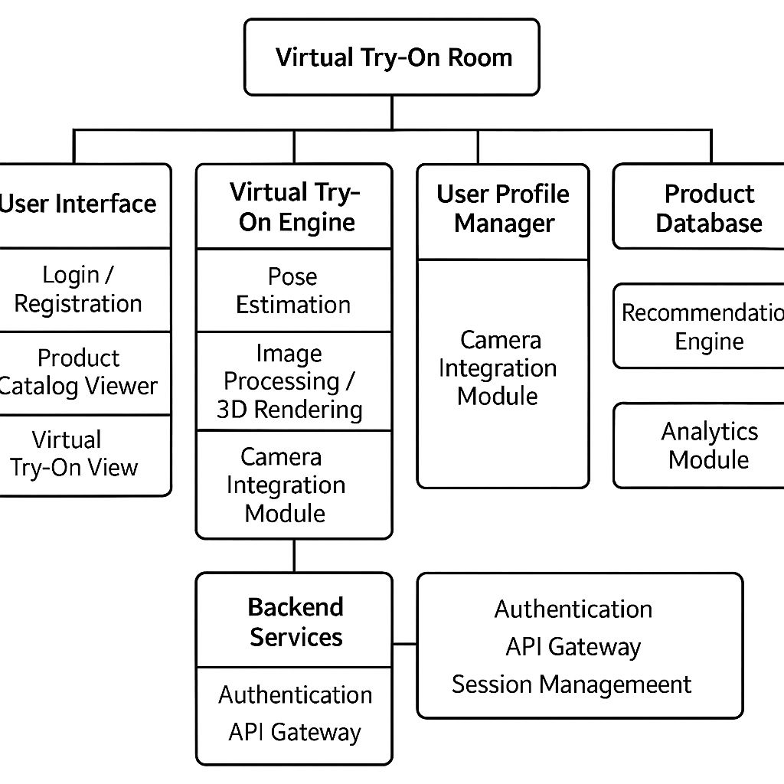
ARCHITECTURE

Slide 12
FLOW EXPLANATION:
Webcam captures the user’s live video feed.
OpenCV processes the video frames in real-time.
MediaPipe detects body pose and hand gestures for interaction (e.g., raising hand to change outfit).
The data is passed to the Virtual Trial Room, where user input and clothing logic are handled.
The User Interface displays the catalog and responds to gestures.
A CNN model classifies clothing types from a dataset like Fashion-MNIST.
The system overlays virtual garments on the user's body using canvas rendering.
The final output is a live, realistic try-on experience.

Slide 13
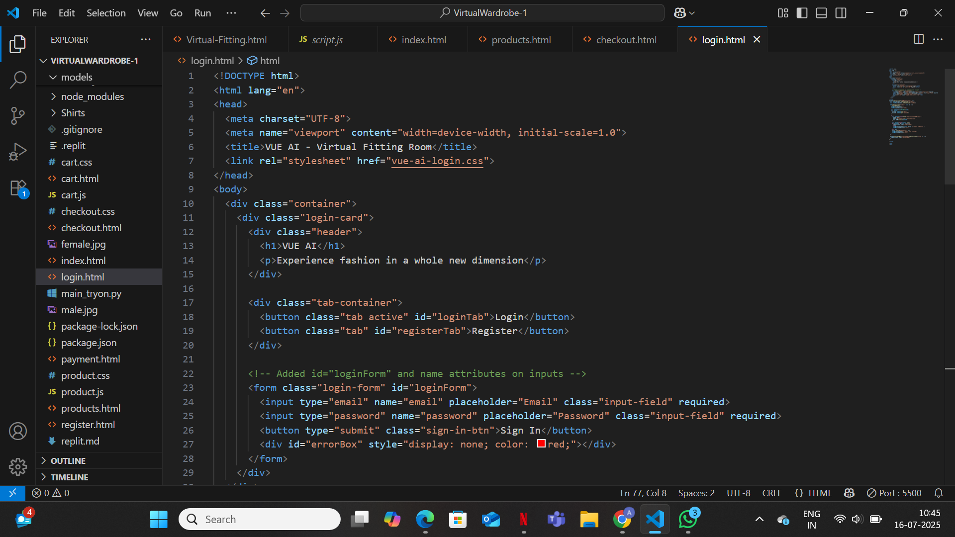
IMPLEMENTATION

Slide 14
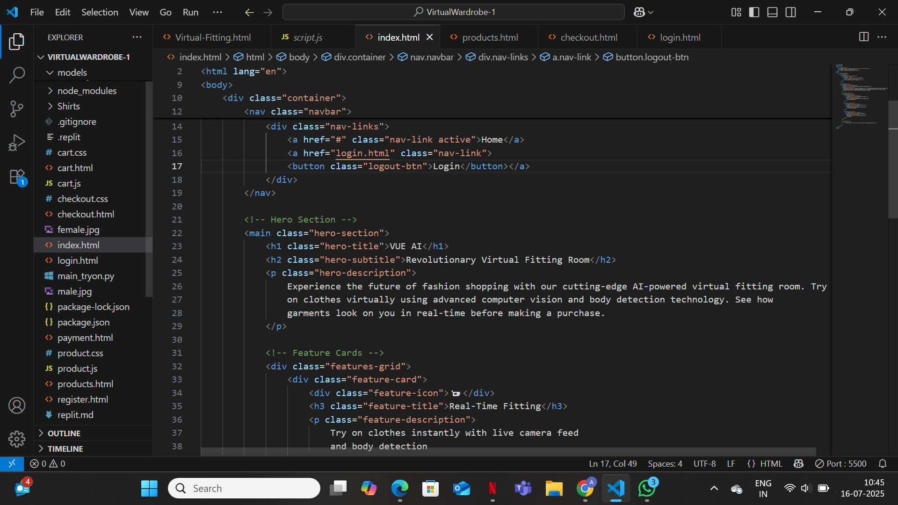

Slide 15
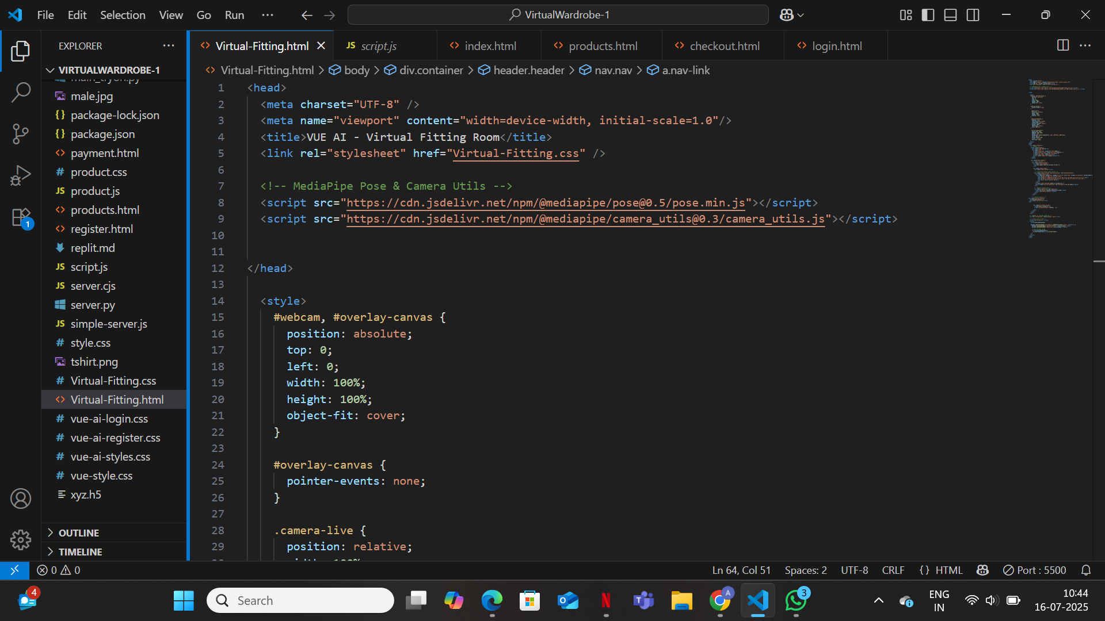

Slide 16
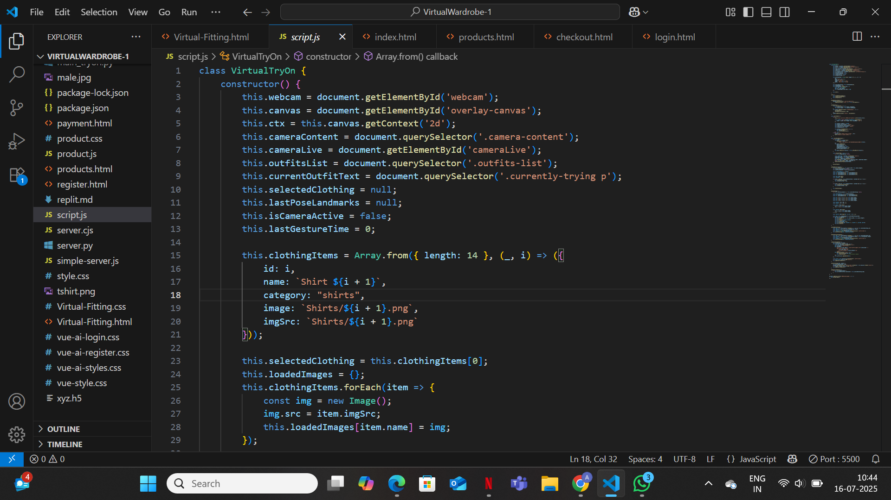

Slide 17
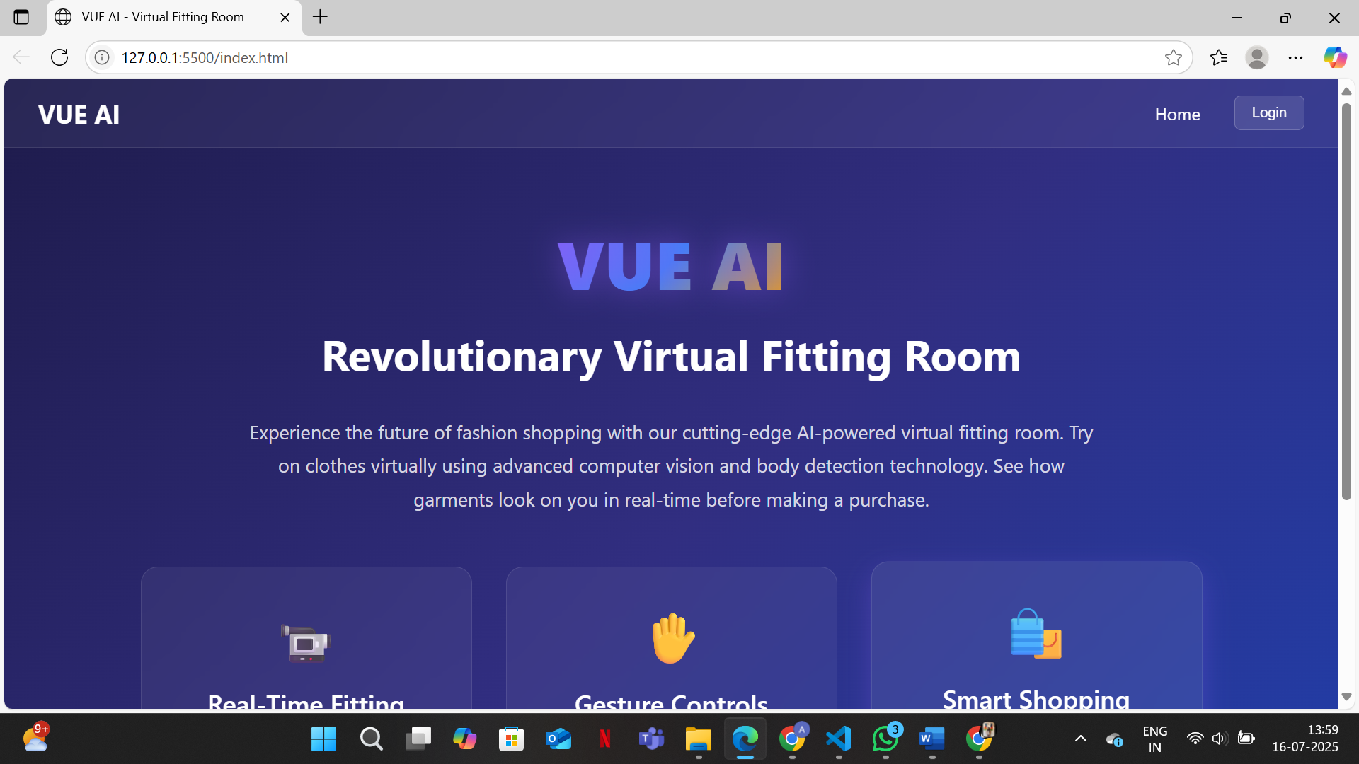

Slide 18
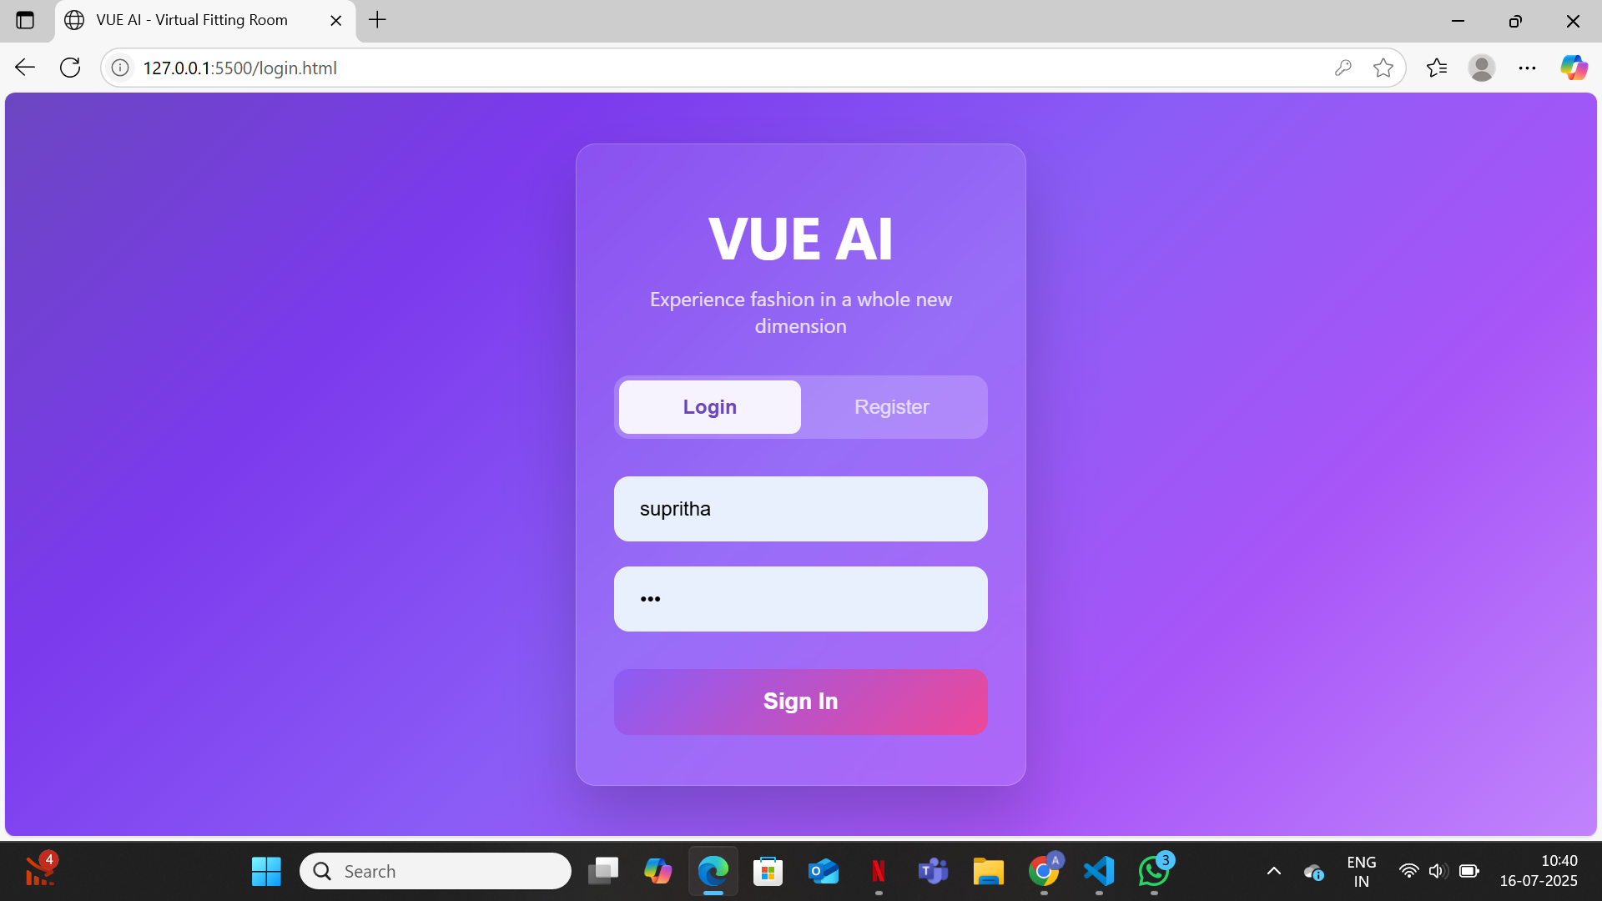

Slide 19
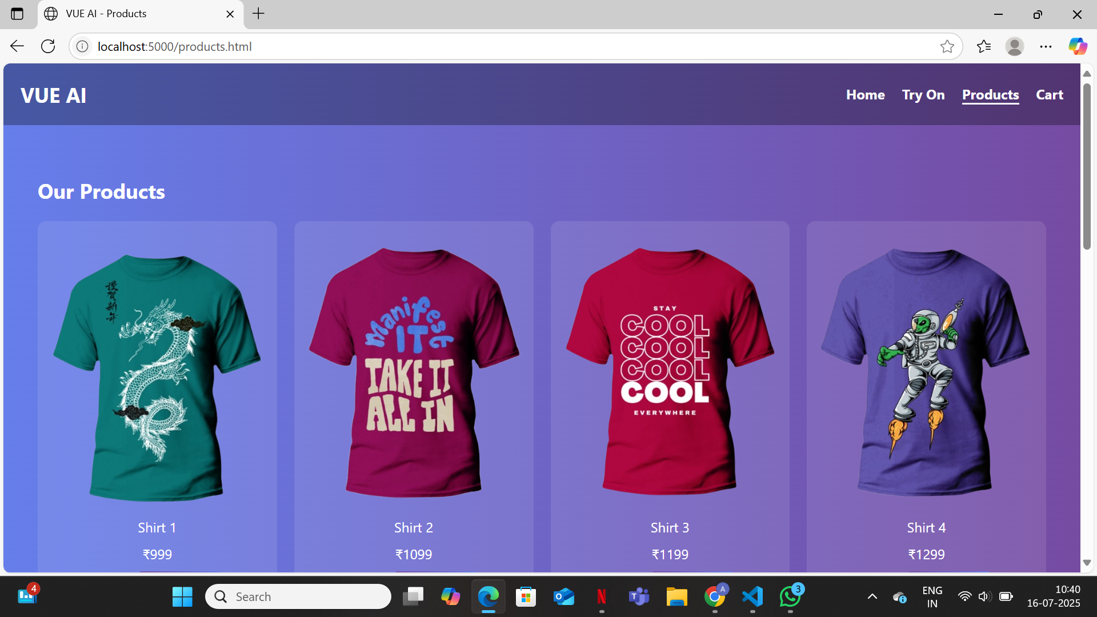

Slide 20
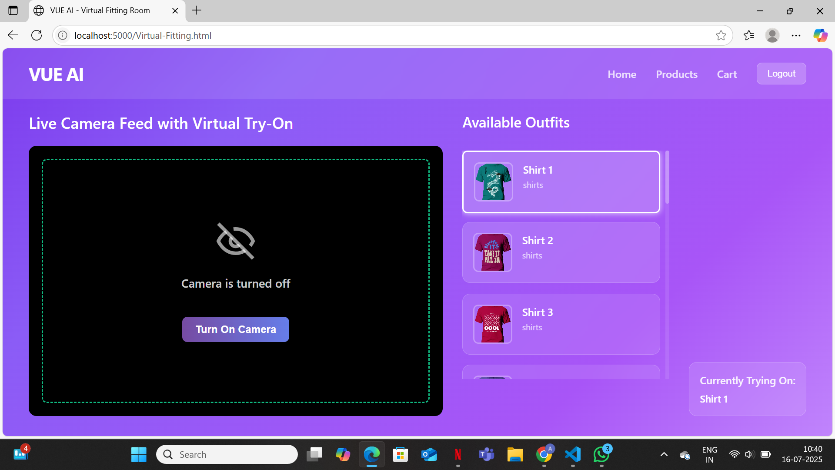

Slide 21
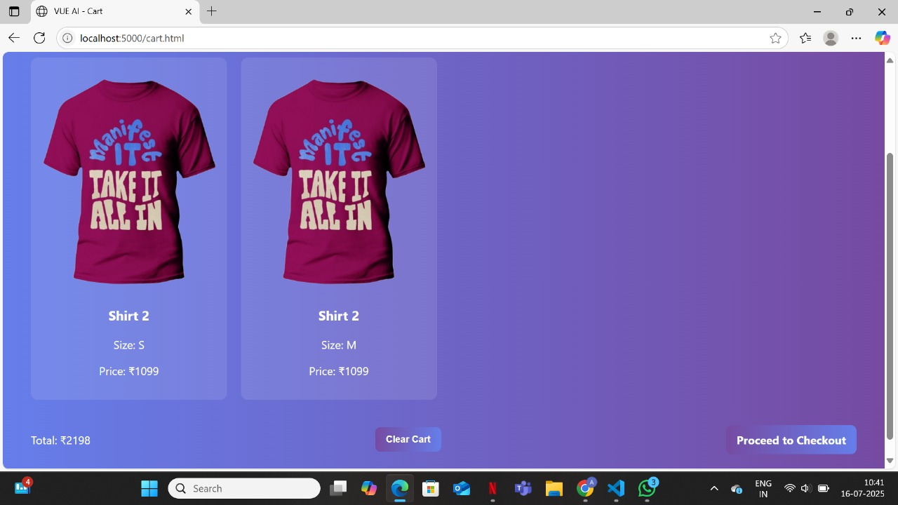

Slide 22
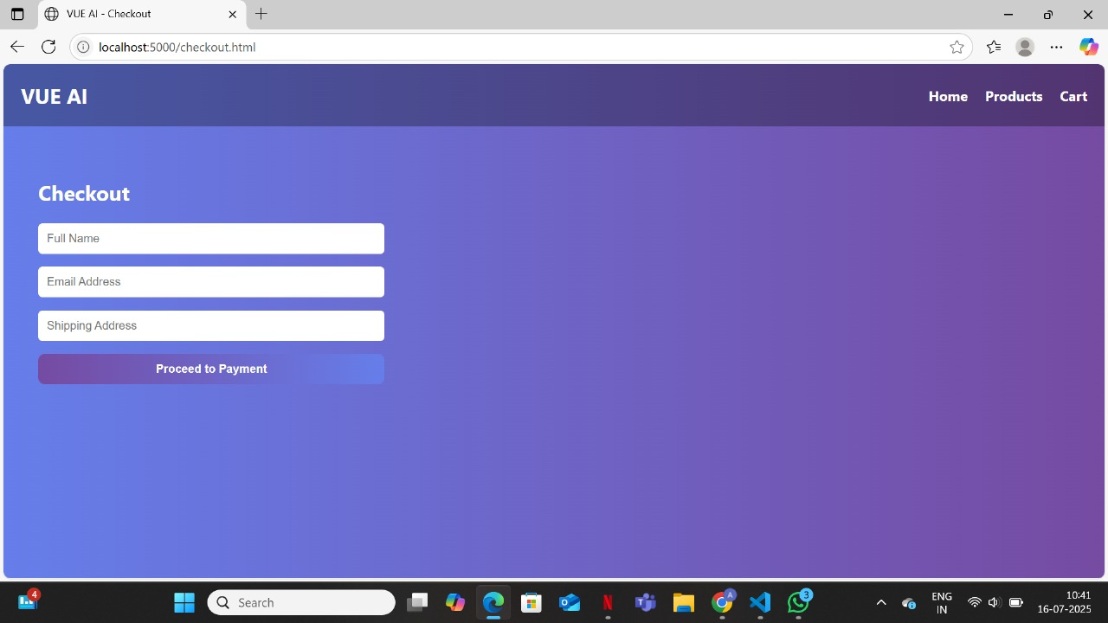

Slide 23
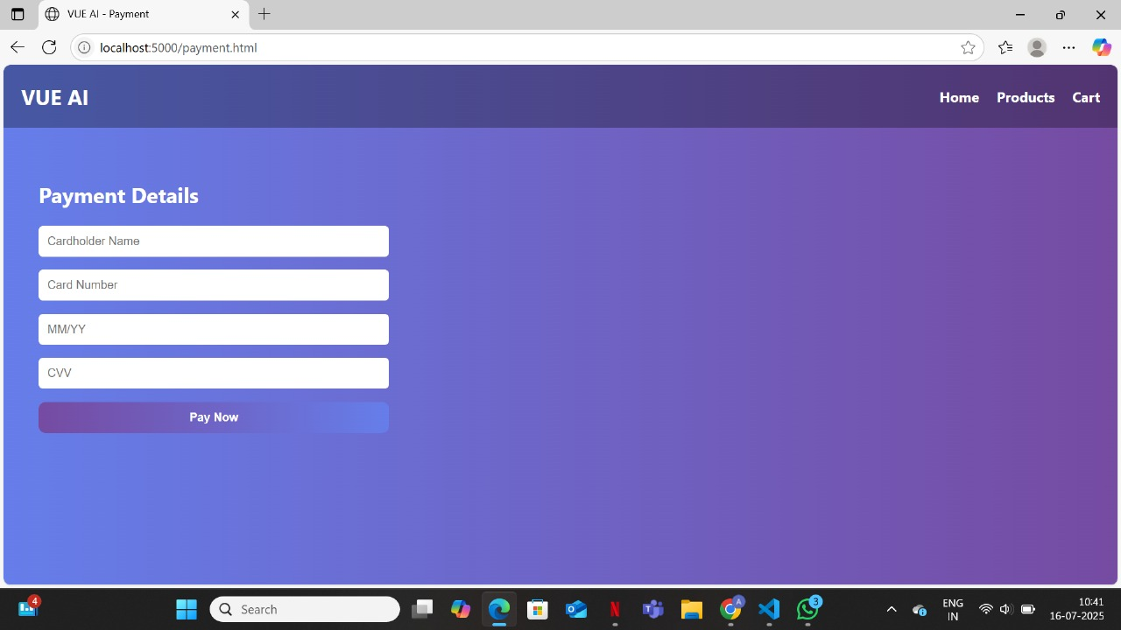

Slide 24
LIMITATIONS
2D overlays lack realistic fit and fabric behavior.
No size suggestions based on body measurements.
Limited gesture control (mainly hand raise only).
Accuracy depends on camera quality and lighting.
Basic clothing catalog with no brand integration.
No e-commerce link for direct shopping.

Slide 25
CONCLUSION
The Virtual Trial Room (VUE.AI) program successfully integrates computer vision, real-time deep learning, and augmented reality to address an online fashion shopping limitation: not trying before buying. Through enabling customers to interact with fashion items virtually—using webcam-based body tracking and natural hand movements—VUE.AI is creating a very immersive and tailored trial experience that enhances customer confidence and buying behavior.The VUE.AI Virtual Trial Room demonstrates how modern web technologies—HTML, CSS, and JavaScript—combined with MediaPipe JS, can create an interactive and immersive online fashion shopping experience. By using a webcam and gesture recognition, users can try on clothes virtually without physical contact. This touchless system enhances hygiene and accessibility, especially in retail kiosks and public settings.The system’s layered and modular architecture allows easy integration and scalability. It can be extended to support more complex garments, accessories, and real-time e-commerce platforms. Despite being lightweight, the platform delivers high accuracy in pose and gesture detection, operating smoothly on standard devices with at least 4GB RAM.VUE.AI improves online shopping by increasing user confidence, reducing return rates, and promoting sustainability in fashion retail. It offers a user-friendly interface, real-time interaction, and cross-platform compatibility, making it a practical solution for both consumers and retailers.

Slide 26
FUTURE SCOPE
The Virtual Trial Room (VUE.AI) holds enormous potential for future upgrade and real-world application. One of the principal future directions is expanding the system to enable full-body garment trials, including pants, skirts, dresses, and accessories like shoes or handbags. This would give a total outfit simulation experience, closer to in-store shopping experiences.Another major feature addition is real-time cloth simulation support. Using the physics-based animation engines or the GAN-based texture mapping, the system would be able to display dynamically draping, deforming, and lighting of clothing—making virtual clothes virtually real.Voice control and multilingual command support can facilitate access for disabled or inexperience users who are not used to traditional interface conventions. This would allow users to perform garment browsing, selection, and trial behavior through natural speech input.The introduction of AI-driven fashion suggestion websites is also a key area to build. Through user behavior, body type, seasonality, and style analysis, the platform would be in a position to actively suggest attire that would fit well and be enjoyed by the user and consequently boost user engagement and satisfaction.In addition, the VUE.AI platform can be merely extended to support use from mobile platforms and with smart mirrors, AR glasses, and interactive store displays. With support for cloud-based user profiles, the system could allow customers to save their preferences, track purchases, and try on new clothes virtually anywhere at any time.Across the world, the Virtual Trial Room is going to be a building block for fashion technology of the future, bringing scalability, personalization, and green value to consumer and business platforms alike.

Slide 27
REFERENCES
[1] Sharma, R. (2020). Smart Budget Management System. International Journal of Engineering Research & Technology (IJERT), 8(6).
[2] Patel, S. (2021). Online Expense Tracker. International Journal for Research in Applied Science and Engineering Technology (IJRASET).
[3] Kushwaha, D. S., & Agrawal, A. (2020). Automated Expense Management using Web Application. International Journal of Scientific Research in Computer Science.
[4] Singh, A., & Verma, R. (2019). Personal Budget Planning and Expense Monitoring System. International Journal of Computer Applications.
[5] Silberschatz, A., Galvin, P. B., & Gagne, G. (2011). Database System Concepts (6th ed.). McGraw-Hill.

Slide 28
[6] Pressman, R. S. (2014). Software Engineering: A Practitioner’s Approach (8th ed.). McGraw-Hill Education.
[7] Firebase Documentation. (n.d.). Realtime Database. Retrieved from https://firebase.google.com/docs/database
[8] Twilio API Docs. (n.d.). Programmable SMS API. Retrieved from https://www.twilio.com/docs/sms
[9] Google Charts. (n.d.). Interactive Chart Tools. Retrieved from https://developers.google.com/chart
[10] Mint by Intuit. (n.d.). Personal Finance and Budgeting App. Retrieved from https://www.mint.com

Slide 29
Thank You

